Slide 1
CSS Awareness Seminar 2017
By:
Sugandh Munir Banglani (IRS – CSS 2016)
Abdul Lateef (PSP – CSS 2014)
Abdul Samad Nizamani (PAS – CSS 2016)

Slide 2
Outline of Session
Introduction
Exam Stages and Pattern
Life in Service – Perks, problems and success stories
Q & A Session

Slide 3
Why Choose Civil Service as a Career Choice?
Combating the problems of Pakistan
Having a meaningful job
Perks & privileges
Pathway to lucrative assignments (World Bank, UN etc.)
Ticket to Ivy League Universities

Slide 4
Introduction to CSS
Entrance exam to Pakistan’s bureaucracy
Twelve Occupational Groups
Pakistan Administrative Service (PAS)
Police Service of Pakistan (PSP)
Foreign Service of Pakistan (FSP)
Pakistan Customs Service (PCS)
Inland Revenue Service (IRS)
Pakistan Audit & Accounts Service (PAAS)
Military Lands and Cantonment Group (ML&CG)
Office Management Group (OMG)
Commerce and Trade Group (CTG)
Railways - Commercial & Transportation Group (RCTG)
Postal Group (PG)
Information Group (IG)

Slide 5
I WANT TO DO CSS! Now what?

Slide 6
Eligibility Criteria
Candidate must hold at least a Bachelor’s degree
Candidate must be above 21 and under 30 years of age
Candidate must be a citizen of Pakistan

Slide 7
Stages of the CSS-Competitive Exam
Written Exam 1200 marks
Medical Exam
Psychological Assessment
Viva Voce 300 marks
TOTAL 1500 marks

Slide 8
How to Apply
Written exam is conducted in February every year
Online application form is available on FPSC website in October of the preceding year
Closing date: 31st October
Print out of the duly filled application form, along with required documents, to be mailed to FPSC Headquarter

Slide 9
Written Exam
Compulsory subjects 600 marks
English Essay
English Precis and Composition
General Science and Ability (GK 1)
Current Affairs (GK 2)
Pakistan Affairs (GK 3)
Islamic Studies
Optional subjects 600 marks
TOTAL 1200 marks

Slide 10
Passing Scores
Compulsory subjects: 40%
GK 1, 2 and 3 are treated as one subject
Optional subjects: 33%
Aggregate: 50%

Slide 11
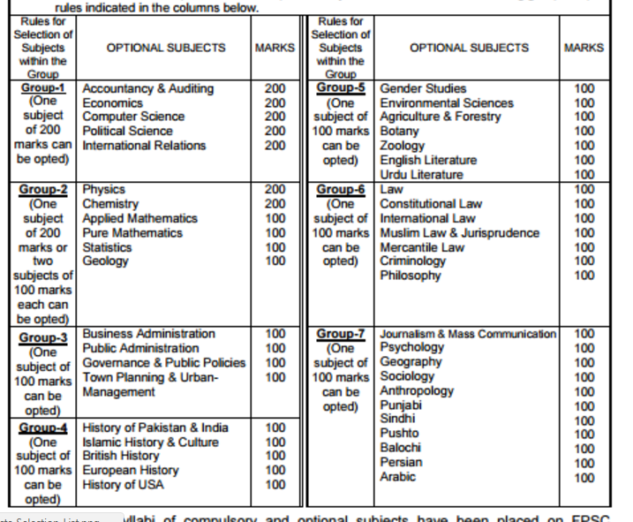

Slide 12
Life in Service - Problems
Postings to far-flung areas
On-call 24/7
Huge array of responsibilities
External intervention
Low pay

Slide 13
Life in Service - Positives
- Job security
- Perks
- Nuisance value
- Nature of Job

Slide 14
Success Stories

Slide 15
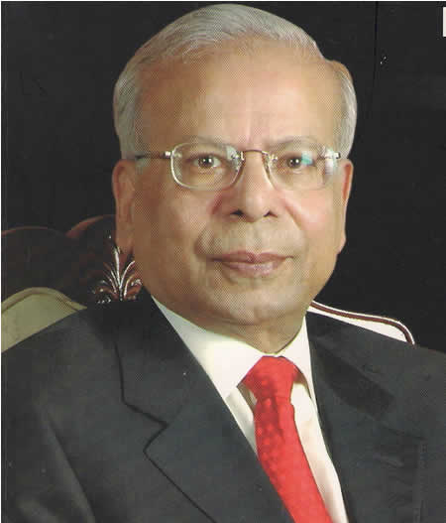
Life in Service – Success Stories
Dr. Ishrat Husain
- Joined civil service in 1964
- World Bank in 1979
- Governor SBP 1999 – 2005
- Dean & Director IBA 2008-2016

Slide 16
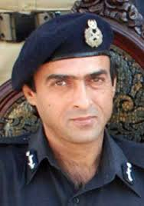
Life in Service – Success Stories
Safwat Ghayur – IG FC
- Joined Police Service of Pakistan in 1981
- Critical role in war on terror
- Numerous terrorist attack on him
- Martyred on 4th August 2010

Slide 17
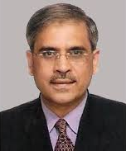
Life in Service – Success Stories
Tariq Bajwa
- Joined Pakistan Administrative Service in 1981
- Master in Public Administration from Harvard
- Current governor State Bank of Pakistan
- Previous Postings:
Secretary Finance
Chairman FBR
Senior Advisor to Executive Director IMF
Head of Trade Mission in Los Angeles

Slide 18
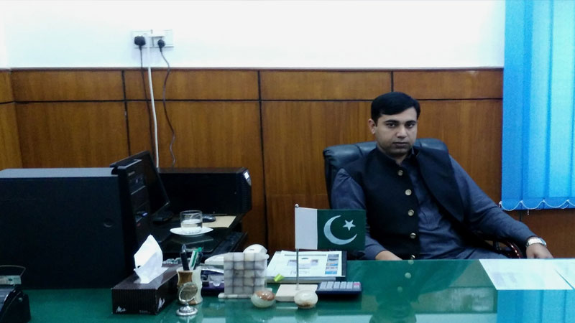
Life in Service – Success Stories
Anwaar Chishti – DAO Muzaffargarh
- Joined PAAS in 2014
- Reported fraud in NBP pension payments
- Recovered Rs. 419 million

Slide 19
Thank you
Question & Answer session

